Slide 1

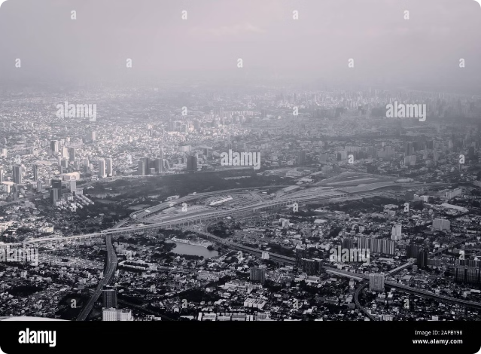
Introduction to Pollution
Pollution is the introduction of harmful substances or products into the environment. It can take many forms, including air, water, soil, and noise pollution, and has serious consequences for the health of our planet and its inhabitants.
pj

Slide 2
Types of Pollution
Air Pollution
Water Pollution
Soil Pollution
Caused by vehicle emissions, industrial processes, and burning of fossil fuels, leading to smog and poor air quality.
Contamination of water bodies by chemicals, sewage, and plastic waste, harming aquatic ecosystems.
Degradation of soil quality from pesticides, heavy metals, and improper waste disposal, impacting agriculture.

Slide 3

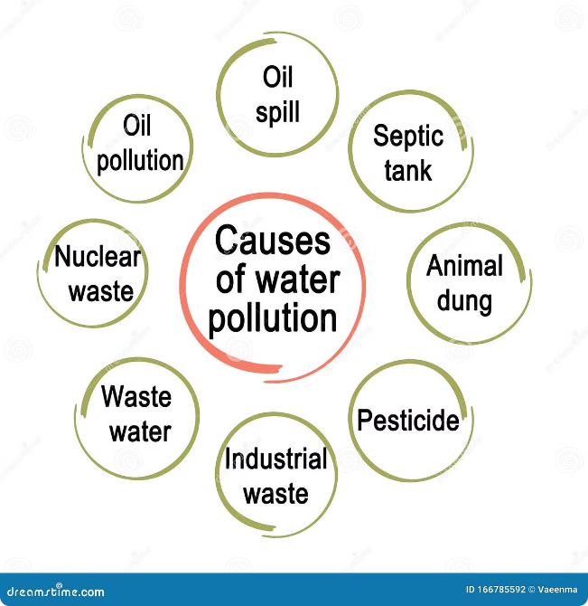
Causes of Pollution
1
Industrialization
Rapid industrial growth and the use of fossil fuels have contributed significantly to pollution.
2
Population Growth
Increased human activity and resource consumption have led to higher waste generation and pollution.
3
Unsustainable Practices
Poor waste management, deforestation, and overuse of pesticides are examples of unsustainable practices.
4
Transportation
Vehicle emissions, including from cars, trucks, and planes, are a major source of air pollution.

Slide 4

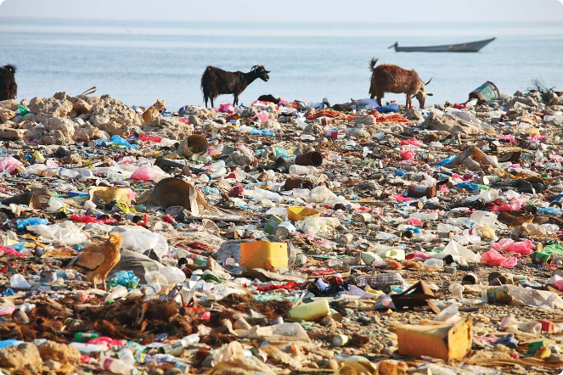
Environmental Impacts of Pollution
Ecosystem Damage
Pollution can disrupt fragile ecosystems, leading to the loss of biodiversity and the degradation of natural habitats.
Climate Change
Greenhouse gas emissions from human activities contribute to global warming and climate change, with far-reaching consequences.
Resource Depletion
Pollution can contaminate and deplete natural resources, such as clean water and arable land, limiting their availability.
Biodiversity Loss
Pollution can cause the extinction of plant and animal species, disrupting the delicate balance of ecosystems.

Slide 5

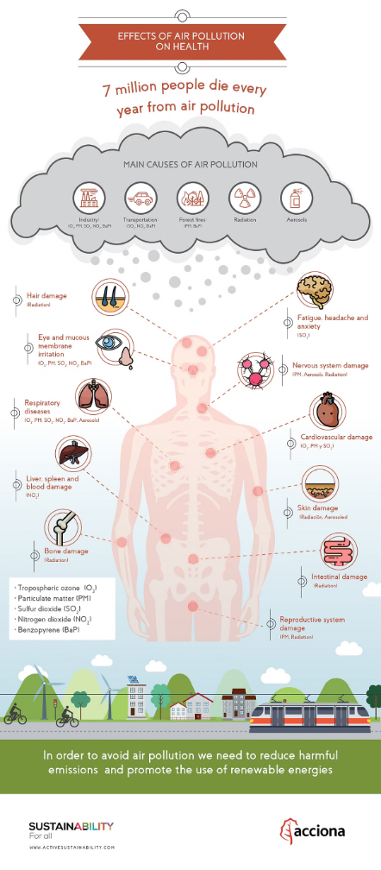



Health Impacts of Pollution
Air Pollution
Increased risk of respiratory diseases, cardiovascular problems, and lung cancer.
Water Pollution
Contaminated water can lead to waterborne illnesses, such as cholera and dysentery.
Soil Pollution
Exposure to heavy metals and toxic chemicals can cause neurological disorders and cancer.

Slide 6

Global Efforts to Reduce Pollution
International Agreements
1
Countries have signed treaties like the Paris Agreement to limit greenhouse gas emissions and address climate change.
2
Sustainable Development Goals
The UN's Sustainable Development Goals include targets for clean water, clean energy, and responsible consumption.
Technological Innovations
3
Advancements in renewable energy, waste management, and green technologies are helping to reduce pollution.

Slide 7


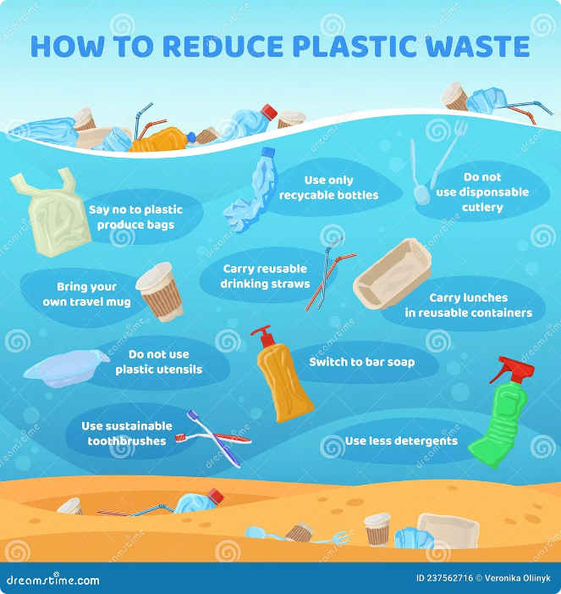



Individual Actions to Combat Pollution
Recycling
Recycle and properly dispose of waste to reduce the amount of trash ending up in landfills and oceans.
Sustainable Transportation
Use public transportation, carpool, or opt for electric vehicles to reduce your carbon footprint.
Energy Efficiency
Conserve energy by using energy-efficient appliances and turning off lights and electronics when not in use.
Eco-Friendly Consumption
Choose products with less packaging, buy local, and support companies with sustainable practices.

Slide 8


Conclusion and Call to Action
While the challenges posed by pollution are daunting, individual and collective actions can make a significant difference. By adopting sustainable practices and supporting global initiatives, we can work towards a cleaner, healthier, and more resilient planet for generations to come.

